Slide 1


Trends in vegetation changes over wetland areas in Denmark using remote sensing data
Sebastian Gutierrez
Mogens Humlekrog Greve
Lis Wollesen de Jonge
EGU22-2545
Session GI6.1

Slide 2

Context
Wetlands provide a range of ecosystem services such as drought resistance, flood resistance, nutrient deposition, and biodiversity.
The decline in the wetland area → Aims to increase the area of arable land, urban development, afforestation, and water reclamation.
Land use is arguably exerting the most significant impact on nature and its life-supporting services.
Composition
Configuration
Intensity
European Union's Biodiversity Strategy for 2030: Aims to restore degraded ecosystems and address key drivers of biodiversity loss → wetland restoration
Satellite images and spectral indices have become a new tool for accurate monitoring of land use and cover changes over large areas (Highly dynamic → we need to include the time factor).
This work aims to determine the NDVI temporal trends (2005 and 2020) and its relationship with the land-use and cover changes in the same period for wetland areas across Denmark.
Qiu et al. (2021)
Notes:
. Change detection methods between two years based on bi-temporal information may lead up to the detection of pseudo-changes, which hinders the land-use and cover monitoring process at different scales. Land-use intensity mediates ecosystem service tradeoffs across regional social-ecological systems.

Slide 3

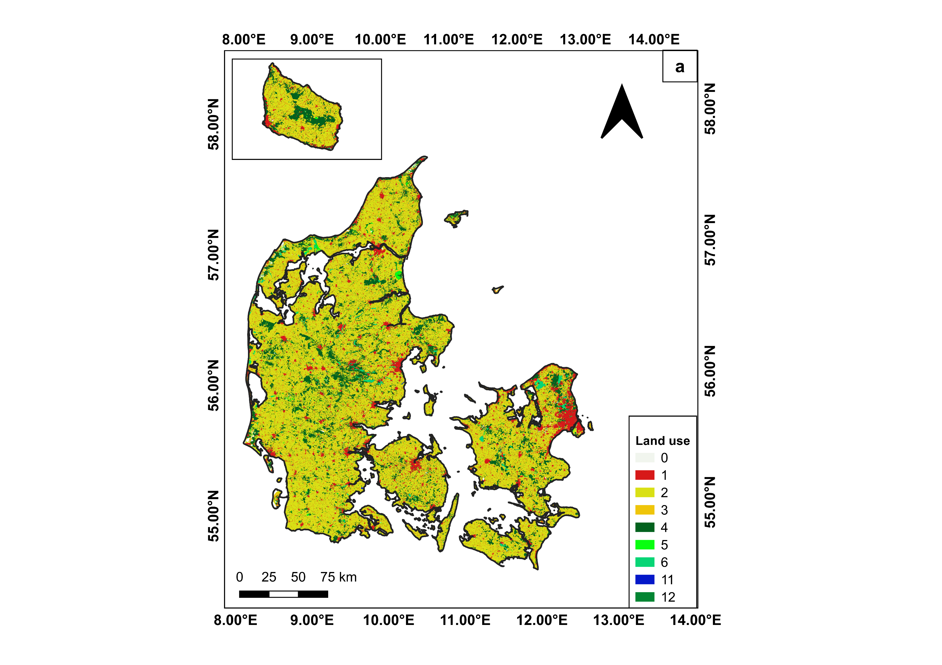




MethoDS
Annual NDVI time series (2005-2020) – Wetland areas (9837.1 km²)
Pixel-wise Theil-sen regression + Mann-Kendall trend test (10.645.135 pixels)
NDVI
NDVI
Slope
P-value
Landsat 7 ETM Tier 1
Landsat 8 OLI Tier 1
2005
2020
2005
2020
Scan to see the repo!
Land use layer 2005
NDVI slope classification
N1: Slope<0 & p-value>0.1
N2: Slope<0 & 0.05<p-value≤0.1
N3: Slope<0 & p-value ≤ 0.05
P1: Slope>0 & p-value>0.1
P2: Slope>0 & 0.05<p-value≤0.1
P3: Slope>0 & p-value>0.05
Land use transition matrix
Land use layer 2020
Chi-square test – determine whether NDVI slope classes and land use transitions are likely to be related or not.
Notes:
We studied the potentiality of including NDVI temporal curves derived from a yearly time-series Landsat TM images (30-m spatial resolution) to obtain more accurate change detection results. We computed the NDVI temporal trends using pixel-wise Theil-Sen and Man-Kendall tests, then we explored the relationship between NDVI trends and the different land-use and cover change classes.

Slide 4
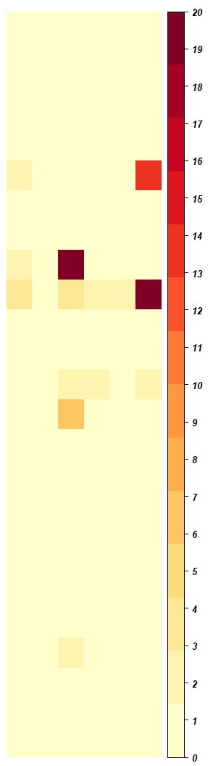
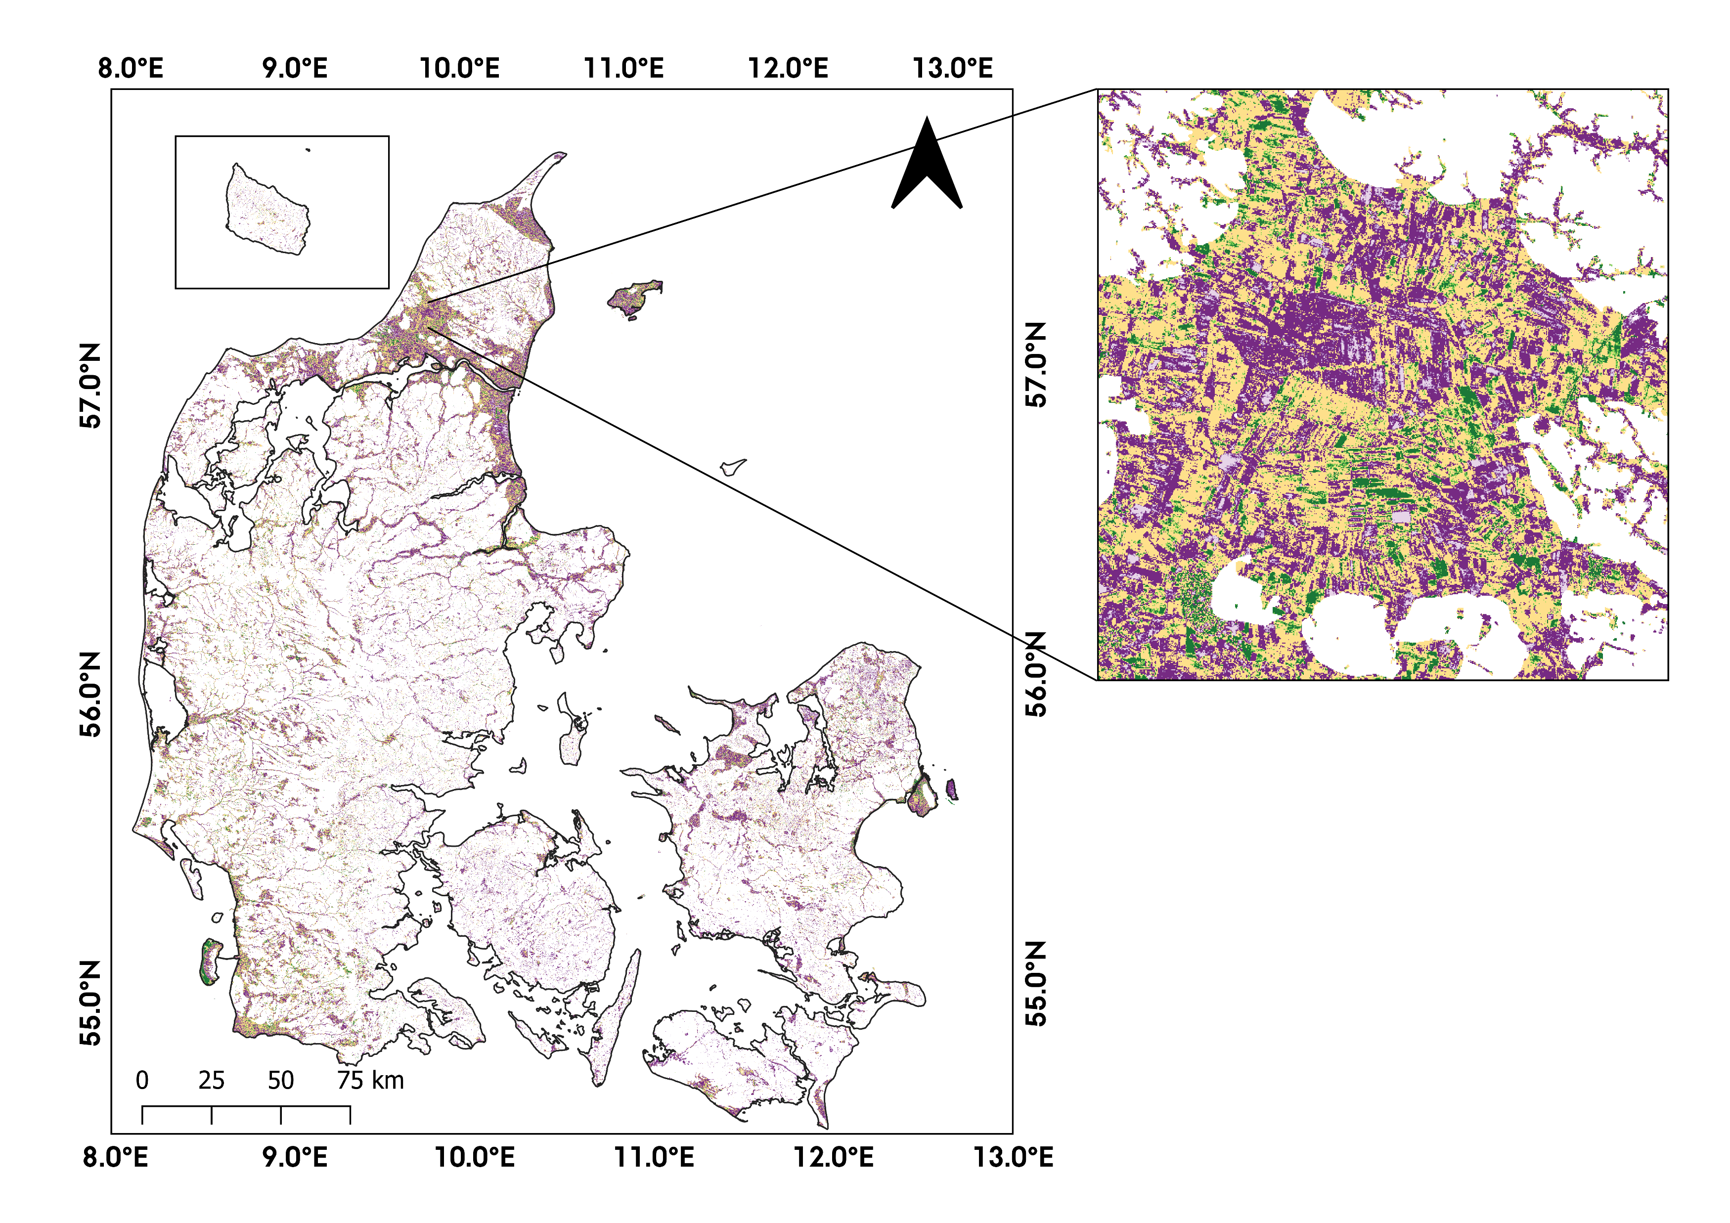
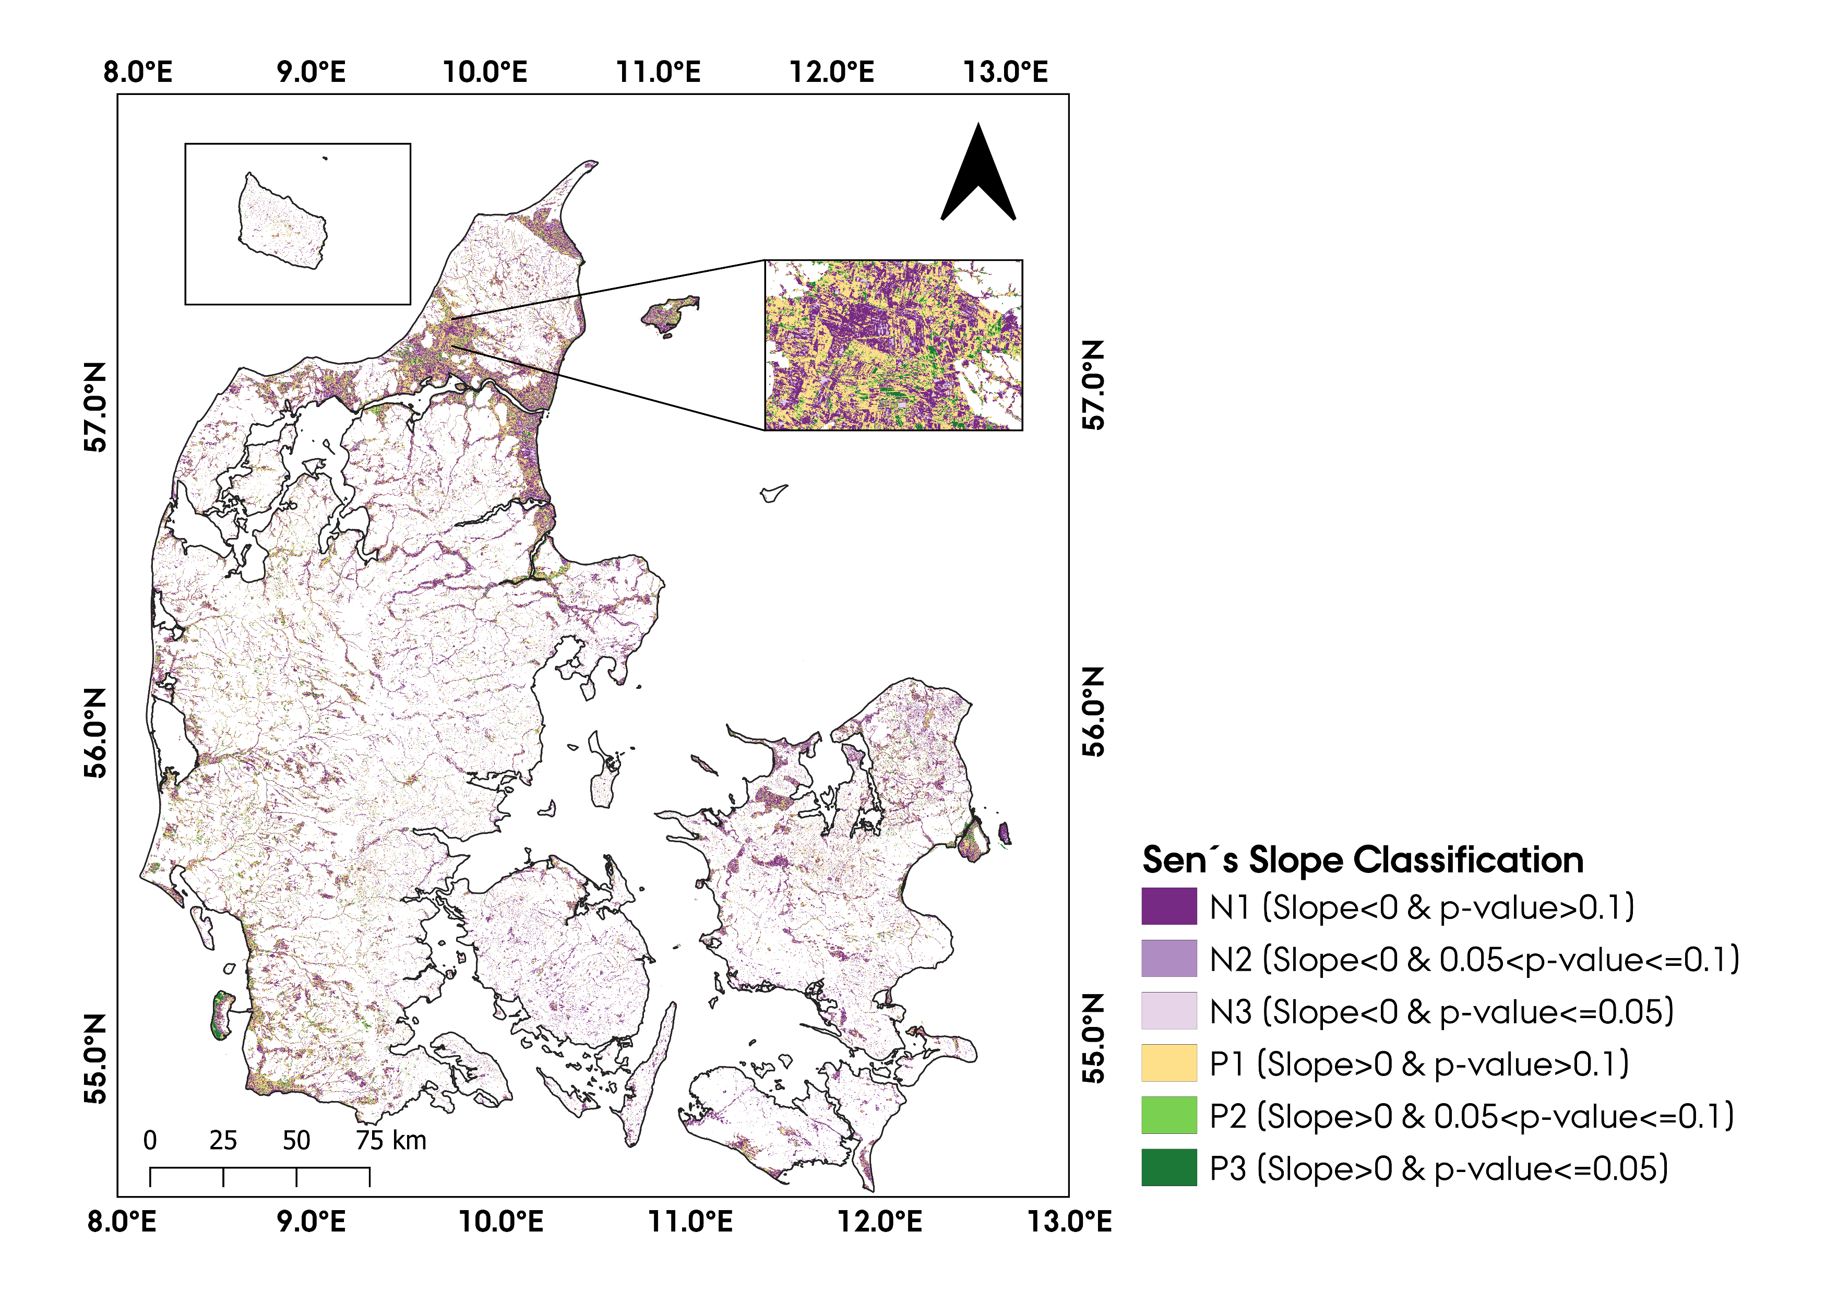
 | N1 | N2 | N3 | P1 | P2 | P3
FCr_Cr
FCr_Gr
FCr_WPr
FCr_WPm
FCr_F
Cr_FCr
Cr_Gr
Cr_WPr
Cr_WPm
Cr_F
Gr_FCr
Gr_Cr
Gr_WPr
Gr_WPm
Gr_F
WPr_FCr
WPr_Cr
WPr_Gr
WPr_WPm
WPr_F
F_FCr
F_Cr
F_Gr
F_WPr
F_WPm
findings
The contribution (%) of a given cell to the total Chi-square score
A significant association between the categories of the two variables (p<0.05).
The contribution of each cell to the total Chi-square score → nature of the dependency between land-use changes and NDVI trends.
Contribution (%)
Cropland-Wetland
Cropland-Forest
Grasslands-Wetlands
FCr: Tree crop, Cr: Cropland, Gr: Grassland, WPr: Periodic wetland, WPm: Permanent wetland, F: Forest
Scan to see the repo!
Notes:
(+ Green) → positive association between corresponding columns and rows
(- Red) → negative association between corresponding columns and rows.
Changes from cropland to wetland and cropland to forest coincided with statistically significant (p≤0.05) negative NDVI, and positive NDVI trends, respectively. Changes from grasslands to permanent wetlands corresponded with statistically significant negative NDVI trends.

Slide 5
Abstract
GitHub Repo

